Slide 1
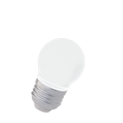
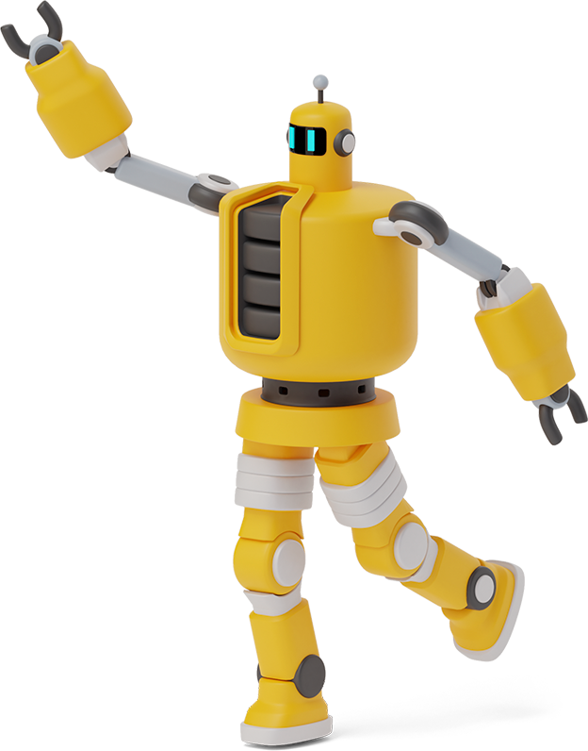
VOICE CONTROLLER ROBOT
BY:
PRATEEK GANGURDE
SOURABH BHALERAO

Slide 2

Currently exisiting system
Amazon Echo
This is a popular smart speaker that uses Amazon's Alexa voice assistant to perform a variety of tasks, such as playing music, controlling smart home devices, and answering questions.
Google Home
This is another smart speaker that uses Google Assistant to perform similar tasks as the Amazon Echo.
iRobot Roomba
This is a popular robot vacuum cleaner that can be controlled with voice commands through Amazon Alexa or Google Assistant.
Anki Cozmo
This is a toy robot that can be controlled with voice commands and can perform a variety of tasks, such as playing games and exploring its environment.
Boston Dynamics Spot
This is a sophisticated robot that can be controlled with voice commands and is used in a variety of industrial settings, such as construction and inspection.

Slide 3
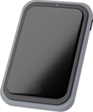
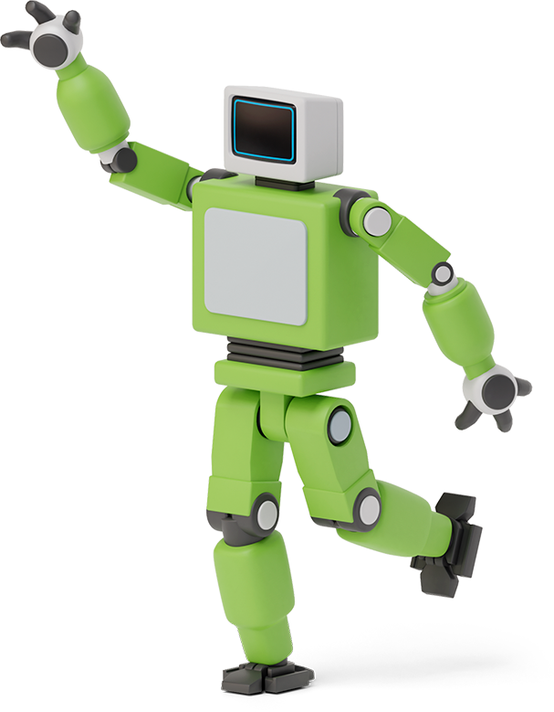

BRIEFING OF THE PROJECT
Needs to be able to accurately recognize and interpret voice commands.
It should provide feedback and confirmation to the user when it receives a voice command.
It should be able to understand the context in which a command is given, so that it can provide appropriate responses.
It should be able to connect and work with multiple devices such as smartphones, smartwatches, tablets, and other smart home devices.
It should be accessible to users with different abilities, such as those who are visually or hearing impaired.

Slide 4

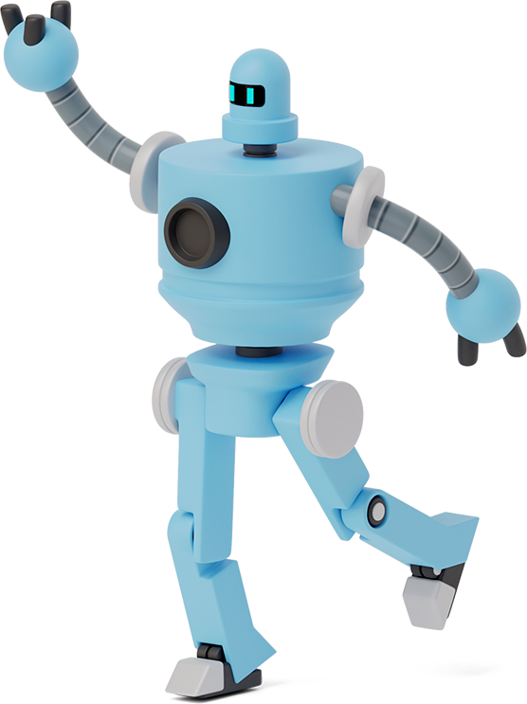
STAKEHOLDERS
Manufacturers
Developers
Users
Regulators
Investors
Service Providers

Slide 5

SOFTWARE & HARDWARE REQUIREMENT
SOFTWARE:
C/C++
Arduino IDE
MIT App Inventor
HARDWARE:
Node MCU ESP8266
Motor Shield (L29n)
Ultrasonic Sensor(HC-SR04)
Tower Pro 9G Micro Servo Motor

Slide 6
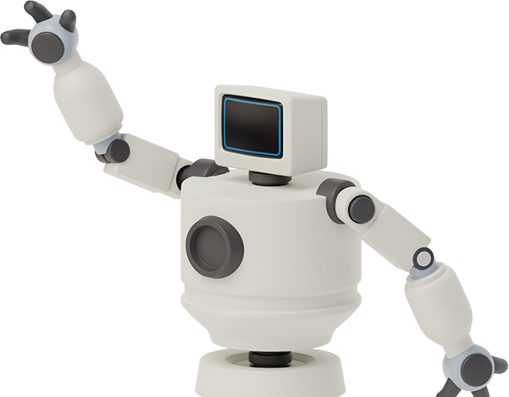

methodology
Design of Prototype Model
Development of Mobile Application
Program Node MCU
Manufacture of Robot
Testing of Mobile Application & Robot

Slide 7

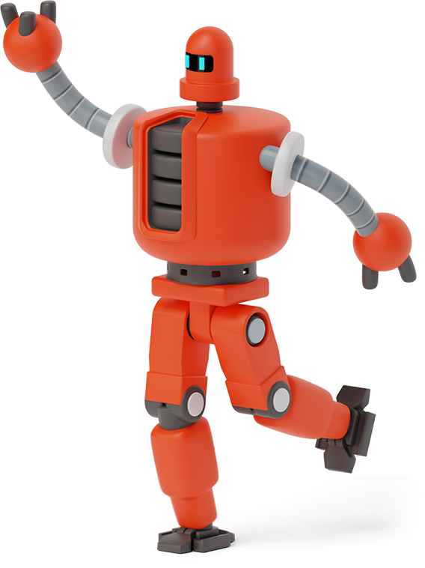
SCOPE OF PROJECT
Home Automation
Industrial Automation
Healthcare
Education
Customer Service
Entertainment

Slide 8
BLOCK DIAGRAM of robot
Android App Voice
Command
NODE
MCU
Driver
IC
Motor
WiFi
Module
RF Transmitter

Slide 9
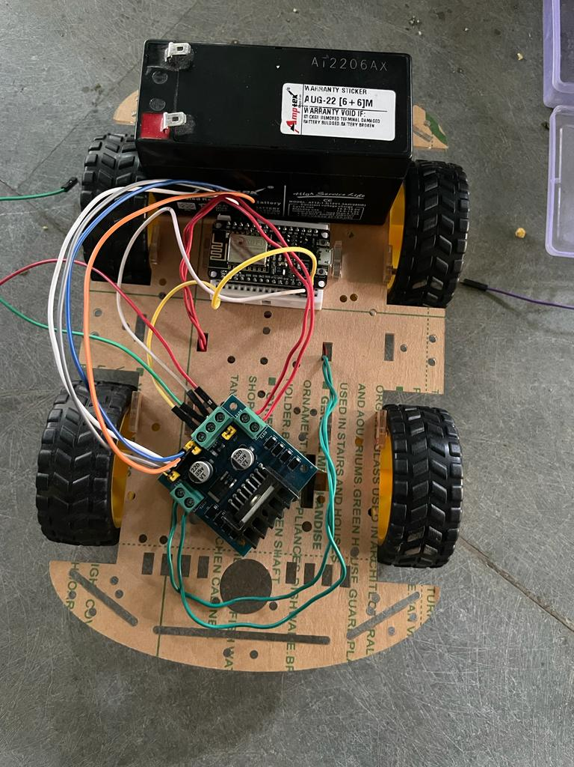
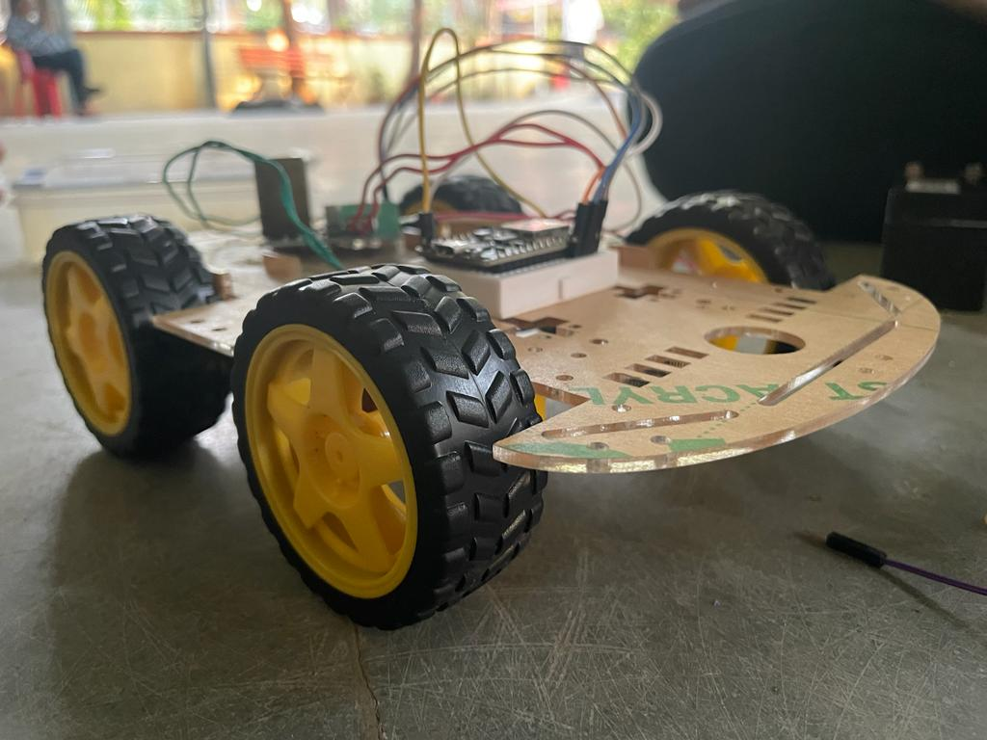
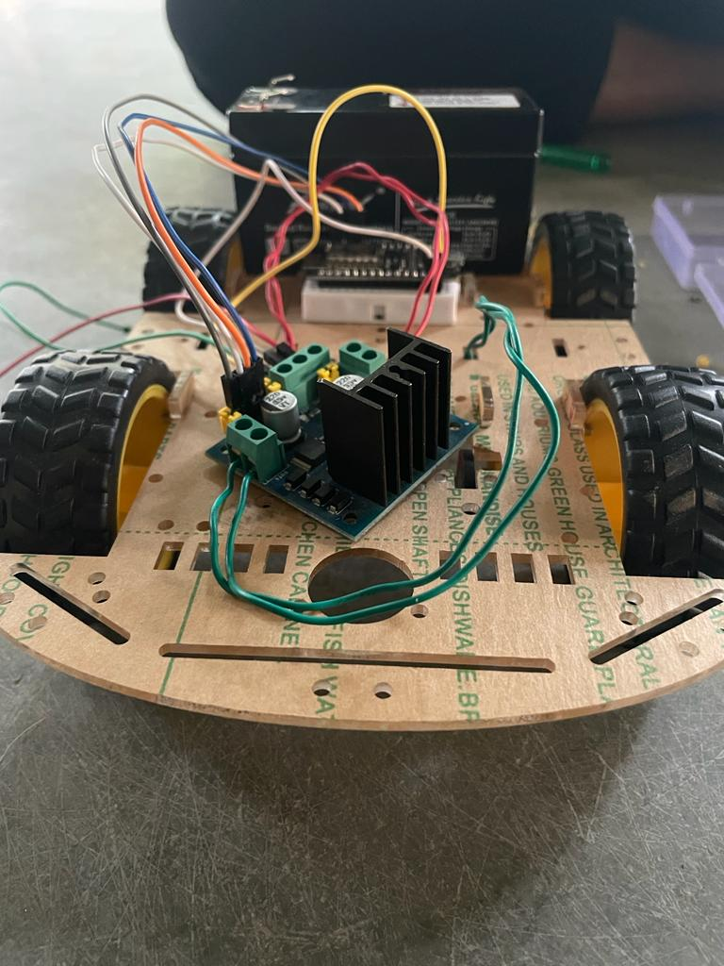
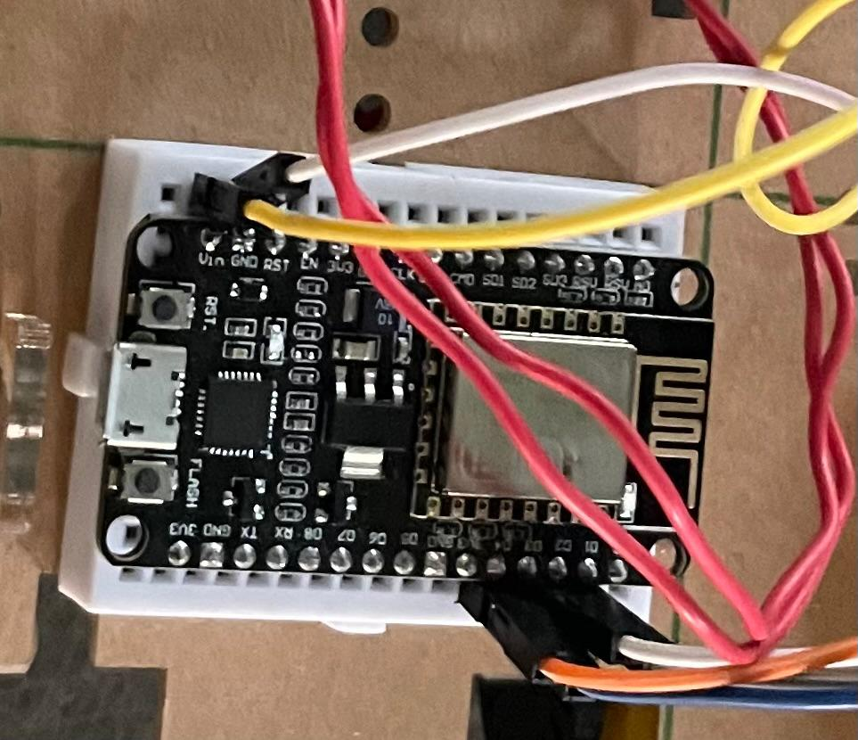
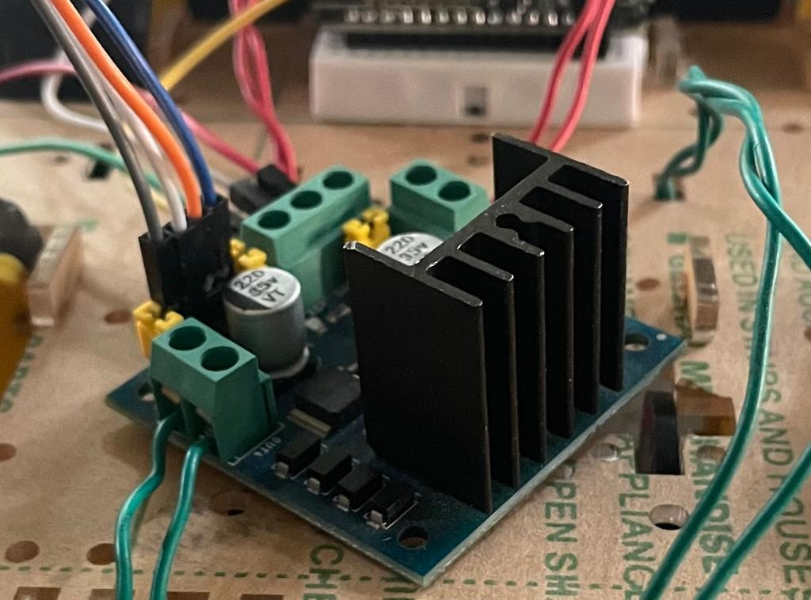
NODE MCU
MOTOR DRIVER

Slide 10
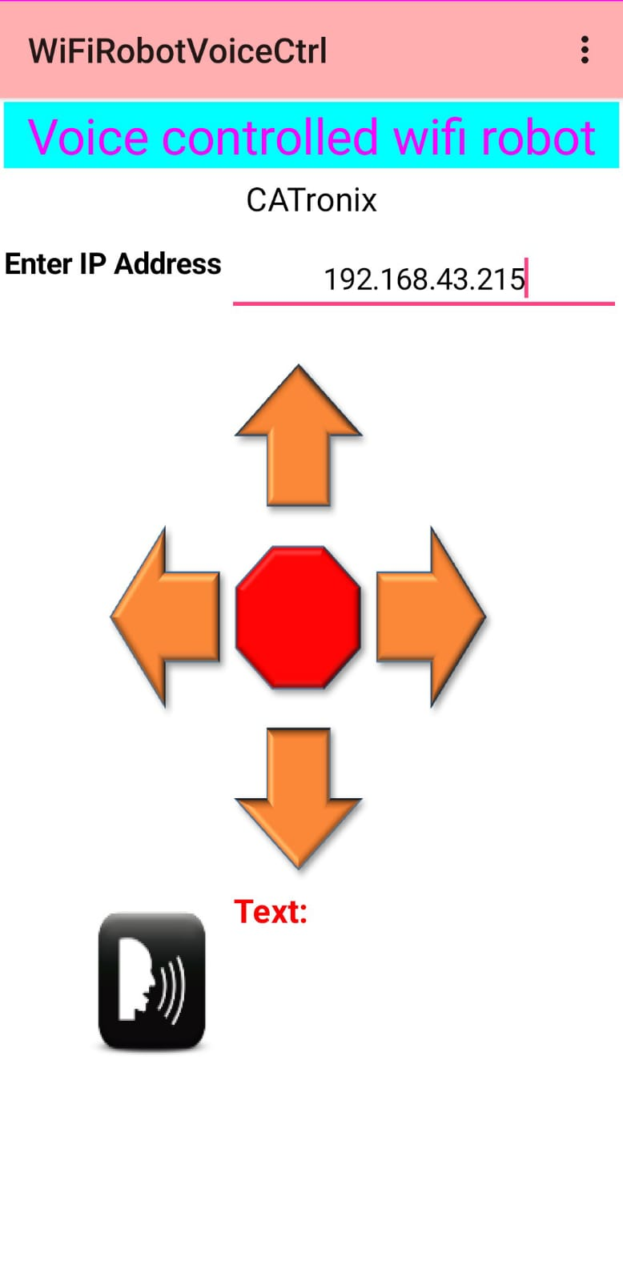
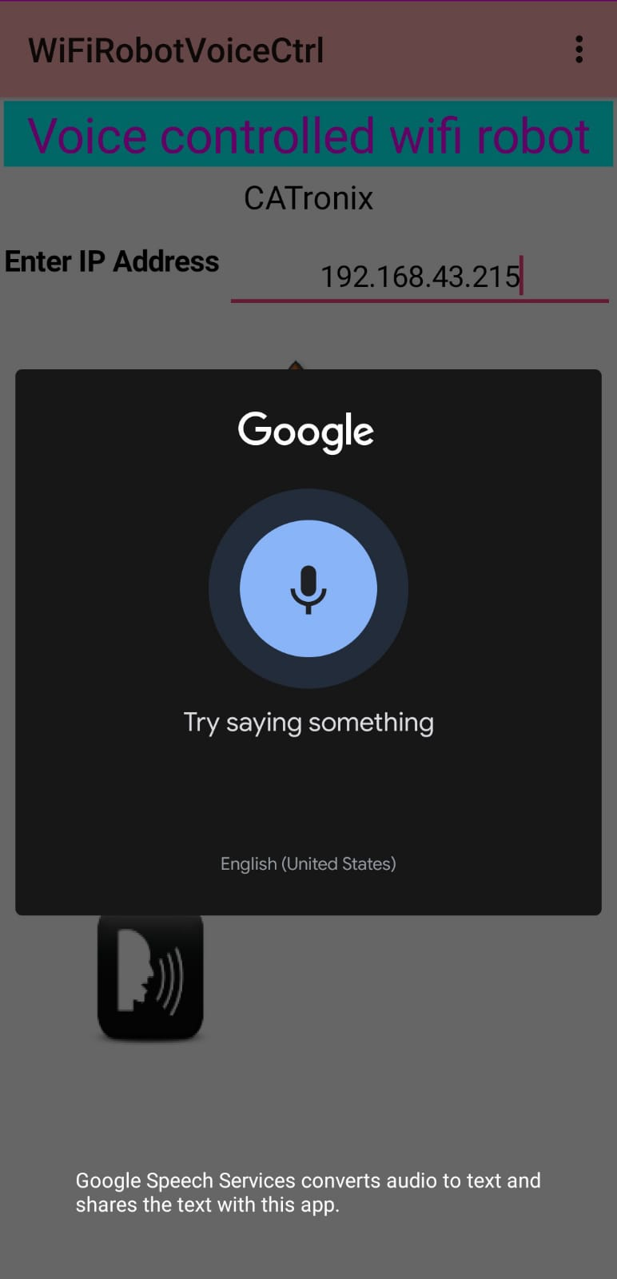
Mobile App
Screenshot

Slide 11
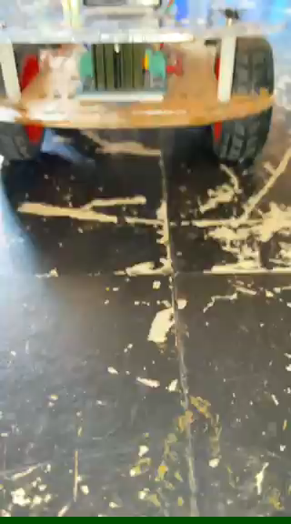

Slide 12
LIMITATION OF PROJECT
Accuracy
Limited Vocabulary
Dependence on Internet Connectivity
Cost
Regular software updates and maintenance
Risk of misunderstanding or misinterpreting

Slide 13
FUTURE ENHANCEMENT
Multimodal Interaction
Improved Physical Interaction
Improved Energy Efficiency
Improved Voice Recognition
Increased Vocabulary

Slide 14
References
https://www.viralsciencecreativity.com/post/Nodemcu -voice-controlledrobot.
https://www.youtube.com/watch?v=QYa02BYWD14
https://www.youtu.be/j7yltf_LtKQ
https://youtu.be/xfmdanZ_Fgc .
https://appinventor.mit.edu

Slide 15
Thanks!
Thanks!
PROJECT BY:
PRATEEK GANGURDE
SOURABH BHALERAO

